Slide 1

Telecom Customer Churn Analysis
Presented By:- Milind Bagad , Darshan Karwa

Slide 2
About Me
Hello, I am Milind Suresh Bagad.
I have completed my bachelors degree in computer Application (BCA).
I’m interested in Data Science because I enjoy working with data, finding patterns, and solving real problems. I enjoy learning new things, improving my skills, and working on projects that make a difference.
Project :-
Grocery Store Analysis using SQL.
Linkedin : https://www.linkedin.com/in/milind-bagad-82786a224
GitHub : https://github.com/Milind5

Slide 3
Objective Of The Project
In today’s competitive telecom market, customer retention has become a major challenge. Many customers are discontinuing their services due to factors like high monthly charges, limited support, poor interne service experience, or short-term contracts
Analyze customer behavior, service usage, billing patterns, and contract types to understand why customers churn.
Identify high-risk customer segments based on tenure, contract, payment method, and services subscribed.
Measure the financial impact of churn by comparing retained revenue vs. lost revenue.
Provide actionable insights that help business teams design effective retention strategies.

Slide 4
Approach To Prove The Business Objective
Understand overall churn magnitude
Identify high-risk customer segments
Analyze impact of service usage
Assess demographic influence
Evaluate pricing and tenure relationship
Measure revenue impact of churn
Enable interactive business exploration

Slide 5
Data Preparation
Dataset Used :-
Telecom Customer Churn Data (7,042 records,21 columns)
Steps Taken :-
    Imported the dataset into Power BI.
    Removed duplicates and handled missing values (mainly in TotalCharges).
    Converted data types – e.g., SeniorCitizen (0/1 → Yes/No).
    Created new columns like:
      Tenure (in months )
      Number of Services
      % of Partners, Dependents, Senior Citizens

Slide 6
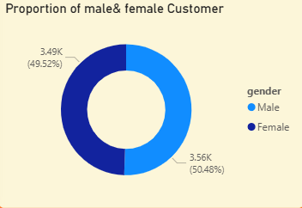
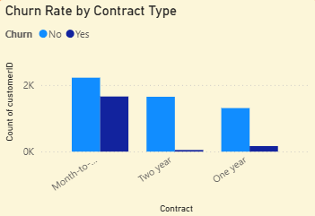
Customer Base Is Evenly Split Between Male and Female
The customer base is almost evenly split between male and female customers, indicating no gender dominance in overall subscriptions.
The customer base is almost evenly split between male and female customers, indicating no gender dominance in overall subscriptions.
Month-to-Month Contracts Drive the Highest Customer Churn
Customers on month-to-month contracts churn significantly more than those on longer-term contracts.

Slide 7
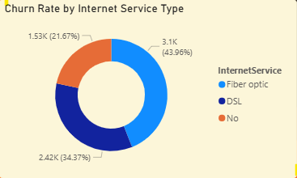
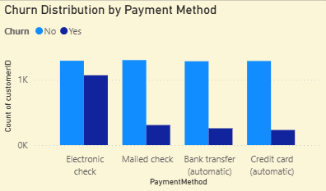
Fiber Optic Customers Contribute the Highest Share of Churn
Fiber optic users account for the largest portion of churn (≈44%), making them the most at-risk customer segment.
DSL customers contribute ~34% of churn, indicating moderate churn risk.
Customers with no internet service show the lowest churn (~22%), suggesting simpler service usage leads to higher retention.
Churn Distribution Across Payment Methods
Electronic check users have the highest number of churned customers, significantly more than any other payment method.
Mailed check customers show moderate churn, but much lower than electronic check users.
Credit card (automatic) users have the lowest churn, indicating strong customer stability.

Slide 8
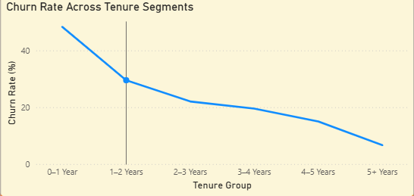
Churn Rate Trend Across Customer Tenure Segments
🔴High-Risk Segment
Customers in the 0–1 year tenure have the highest churn rate (~45–50%), indicating the most critical risk period.
🟡 Medium-Risk Segment
Churn drops sharply after the first year (1–2 years), showing early customer stabilization.
🟢 Low-Risk Segment
Customers with 5+ years tenure have the lowest churn (~5–7%), proving strong long-term loyalty.

Slide 9
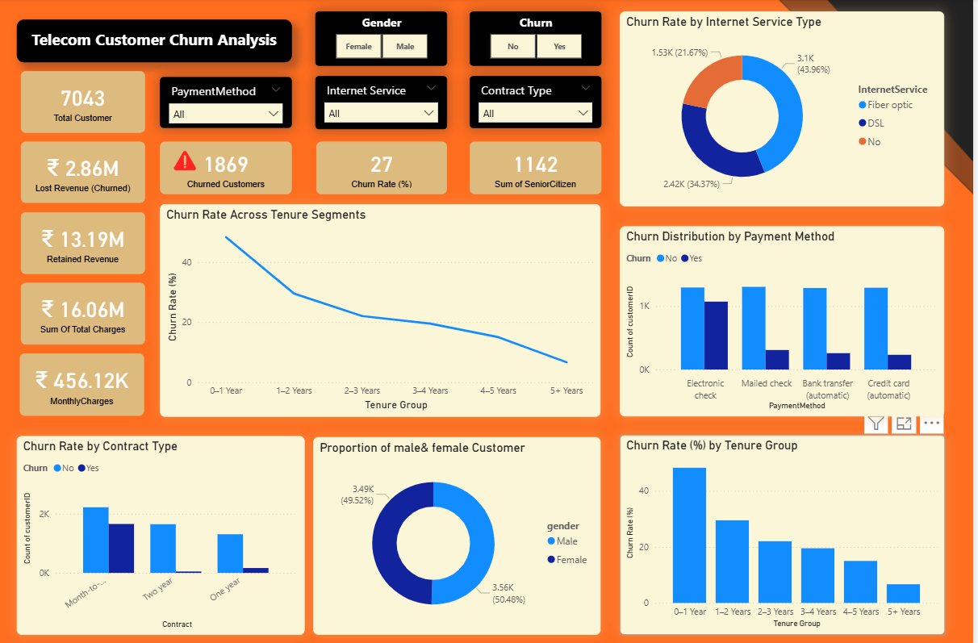
Dashboard

Slide 10
Link To Dashboard
Click Here

Slide 11
Conclusion
Customer churn is significant (~27%), resulting in substantial revenue loss for the telecom business.
Short-tenure customers (0–1 year) and month-to-month contracts show the highest churn risk.
Customers using Fiber Optic internet and Electronic Check payment method are more likely to churn.
Lack of value-added services such as Tech Support and Online Security increases churn probability.
Churn directly impacts revenue, with ₹2.86M lost from churned customers compared to ₹13.19M retained revenue.
Interactive analysis enables the business to identify high-risk segments early and take preventive action.

Slide 12


